Slide 1
Chapter 29. Unsupervised Learning
Jesse Simpson, JunHyeong Lee

Slide 2
Background
Focusing on clustering
Used less often than supervised learning
Harder to apply and measure success
The curse of dimensionality
Notes:
-As a feature space expands in dimensionality, the data becomes increasingly sparse; the data needed to fill this space for statistically meaningful results increase rapidly with any increase in dimensionality.
-More noise;

Slide 3
Use Cases
Pattern recognition
Finding anomalies in data
Topic modeling
Notes:
-deriving a concise representation of the underlying structure of a given dataset
-If the majority of values in a dataset cluster into a larger group with several small groups on the outside, those groups might warrant further investigation.
-By looking at large bodies of text, it is possible to find topics that exist across those different documents.

Slide 4
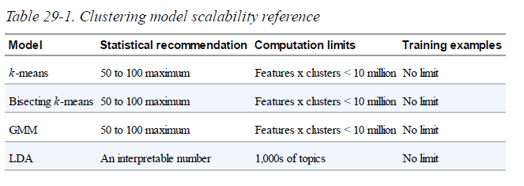
Clustering model scalability

Slide 5
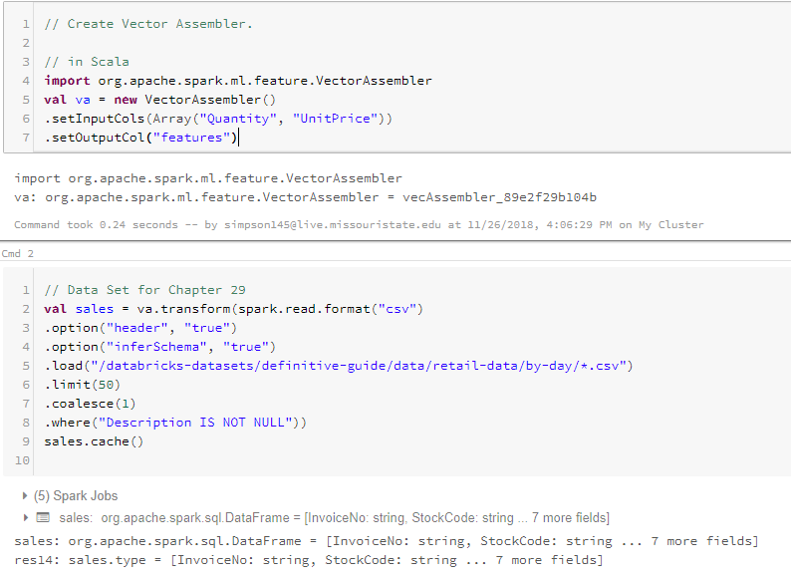
Dataset

Slide 6
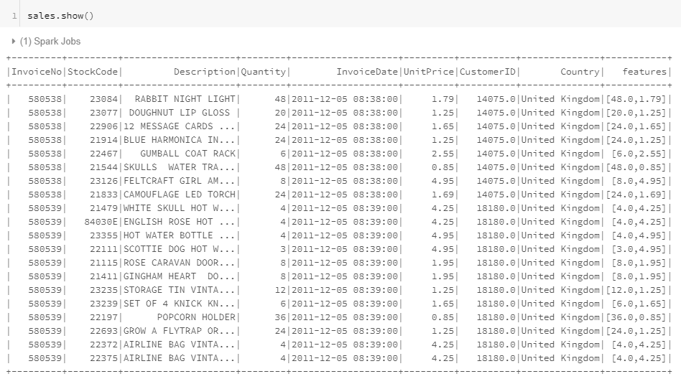
Dataset Shown

Slide 7
K-means
One of the most popular clustering algorithms
Centroid
Terminate condition
Finite number of iterations
Centroid locations does not update anymore
http://stanford.edu/class/ee103/visualizations/kmeans/kmeans.html
Notes:
- A user-specified number of clusters are randomly assigned to different points in the dataset. The unassigned points are then assigned to a cluster based on their proximity to the previously assigned point.
-Just because there is a cluster formed in the dataset, it doesn’t mean that cluster will fall into the same centroid.

Slide 8

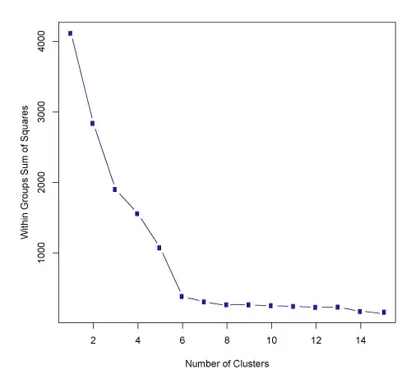
How to choose the number of clusters?
Visually inspect the datapoints
Elbow method
The idea is to find the K at which the SSE decreases most abruptly.
Heuristic
Notes:
-This is not an easy task
-Compute the sum of squared error for some values of K such as 2,3,4,5,6, and so on.
-SSE is defined as the sum of the squared distance between each member of the cluster and its centroid. Also called Variance
-Heuristic - this may or may not work well in your dataset. There can be multiple elbows, or no elbow at all. In those cases, you just try out those elbows and see which one yields the best result.

Slide 9
Training Parameters
K (hyperparamter)
initMode
initSteps
maxIter
tol
Notes:
-number of clusters
-The initialization mode is the algorithm that determines the starting locations of the centroids.
-it determines the number of steps in the kmeans || algorithm
-Specifies the number of iterations; must be greater than 0; default is 2
-Specifies a threshold value; termination condition; default is 0.0001

Slide 10
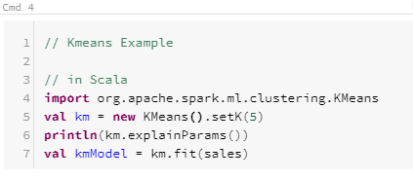
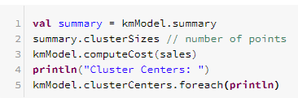

Slide 11
Bisecting K-Means

Slide 12
Bisecting K-means
Bisecting K-means is a variant of K-means.
The core difference is that instead of clustering points by starting “bottom-up” and assigning a bunch of different groups in the data, Bisecting K-means is a top-down clustering method.
This means that it will start by creating a single group and then splitting that group into smaller groups in order to end up with the number of clusters specified by the user.
This is usually a faster method than K-means and will yield different results.

Slide 13
Algorithm Overview
Initial Conditions:
Start with all of the points in one centroid (i.e. Cluster)
But, still decide on the total number of clusters desired
Loop: until the stopping condition for the number of Clusters has been reached
Loop: for every cluster
Measure the total error for the parent cluster in this loop's iteration
Apply the K-Means Algorithm to the cluster with k= 2
Measure the total SSE(Sum of Squared Error) error of the children clusters compared to their parent cluster
Chose the cluster split that gives the lowest error and commit this split
End Loop
End Loop

Slide 14
Algorithm Continued.
Unlike with the K-Means Algorithm, you don’t initialize an K Number of centroids before the algorithm starts because we start with one cluster.
Remember, it is the random initialization of centroids to points for each cluster before the main algorithm of the K-Means algorithm starts that can help for collapsing on local minima instead of global minima.
Like with the K-Means Algorithm, a predetermined number of clusters still must be decided on before the main algorithm is started, which serves as the stopping condition for the algorithm.

Slide 15
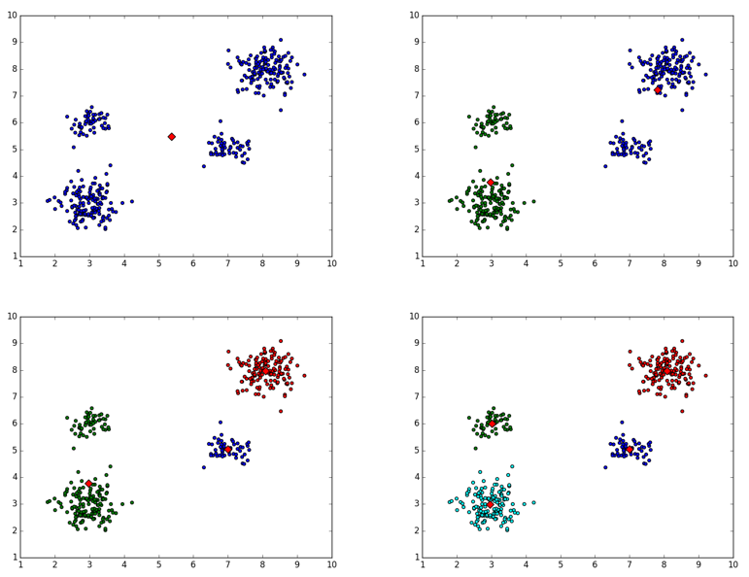
K = 4

Slide 16
Bisecting K-means in Spark
Model Hyperparameters:
k: This is the number of clusters that you would like to end up with.
Training Parameters:
maxIterations: the max number of k-means iterations to split clusters (default: 20)
minDivisibleClusterSize: the minimum number of points (if >= 1.0) or the minimum proportion of points (if < 1.0) of a divisible cluster (default: 1)
Seed: a random seed(default: has value of the class name)

Slide 17
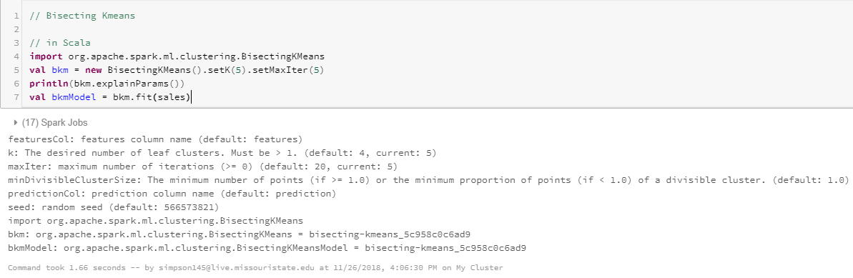
Code Example

Slide 18
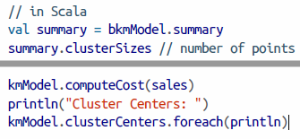
Bisecting K-means Summary
Bisecting -means includes a summary class that we can use to evaluate our model, that is largely the same as the -means summary.
This includes information about the clusters created, as well as their relative sizes (number of examples):
Notes:
Add output to this slide.

Slide 19
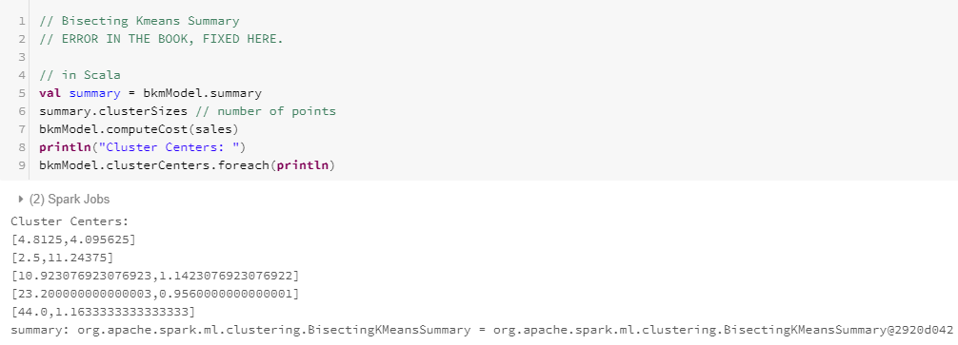
Bisecting K-Means Output

Slide 20
Bisecting K-Means Conclusion
Both K-means and Bisecting K-means take in a parameter K for the number of desired clusters.
The primary difference being one is K-means is a “bottom-up” algorithm and Bisecting K-means is a “top-down” algorithm.
K-means and Bisecting K-means generate can create different clusters on the same data.
Bisecting K-means is usually faster.

Slide 21

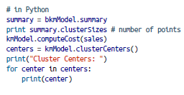
Bisecting Python Code (For Reference)

Slide 22
Gaussian Mixture Models

Slide 23
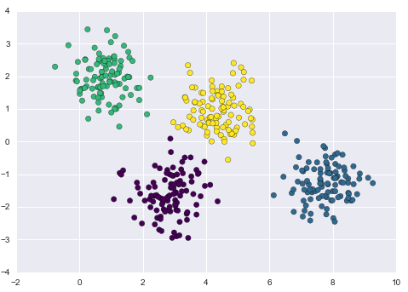
Weakness of the K-means algorithm
Poorly handled overlapping element
Attempts to force-fit the data into the circular clusters (rigid-boundaries)
Notes:
-K-means have no probabilistic way to determine which cluster an element belongs to -> Hard assignment

Slide 24
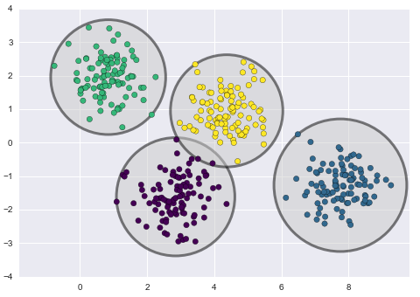

Slide 25
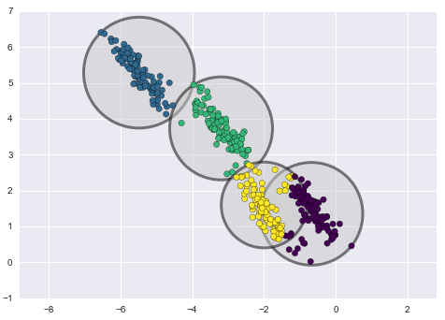
Notes:
We can generalize the k-means by measuring uncertainty in cluster assignment by comparing the distances of each point to all cluster centers, rather than focusing on just the closest. You also want to allow the cluster boundaries to be ellipses rather than circles so that it can be flexible to the dataset like above.

Slide 26
Gaussian Mixture Models
Clustering algorithm
What is Gaussian distribution?
AKA probability density function AKA Bell curve
A function of a continuous random variable
Notes:
-Makes different assumptions than bisecting k-means or k-means do. These algorithms try to group data by reducing the sum of squared distances from the center of the cluster, but GMM assumes that each cluster produces data based upon random draws from a Gaussian distribution.
-A function of a continuous random variable, whose integral across an interval gives the probability that the value of the variable lies within the same interval.

Slide 27
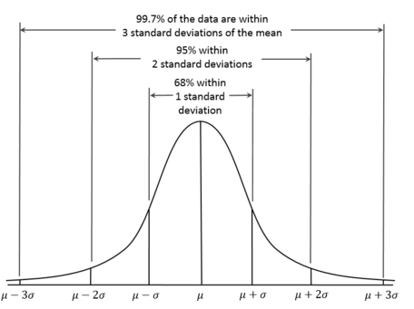

Slide 28
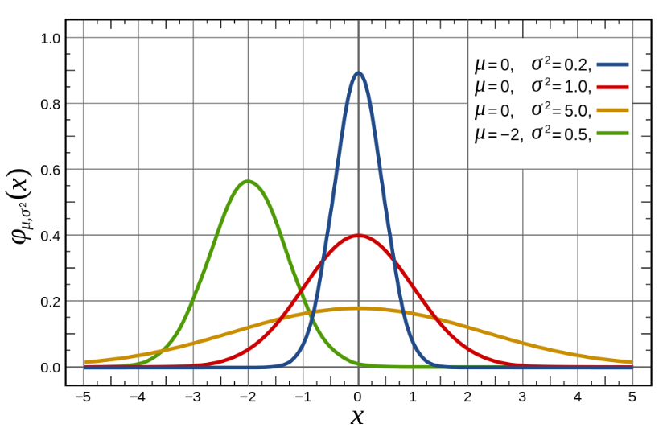

Slide 29
Gaussian Mixture Models (Cont.)
Probability distribution that consists of multiple probability distributions.
Measures the probability that any point belongs to the given cluster
Soft-boundaries
Notes:
-Soft-boundary

Slide 30
Expectation-maximization approach
Choose starting guesses for the location and shape
Repeat until converged:
E-step: for each point, find weights encoding the probability of membership in each cluster
M-step: for each cluster, update its location, normalization, and shape based on ALL data points, making use of the weights
Notes:
-K-means clusters only consider ones that are closest to themselves.
-Result with a smooth Gaussian model
-Can sometime miss the globally optimal solution

Slide 31
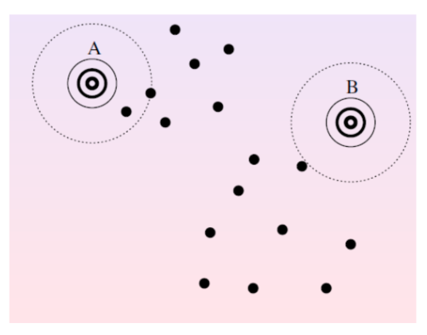
Generate Gaussians (Bell curves) randomly

Slide 32
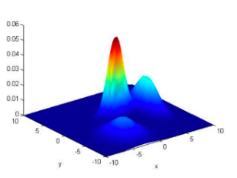

Slide 33
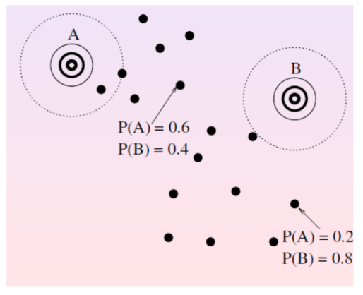
E-Step: estimate the probability for each point

Slide 34
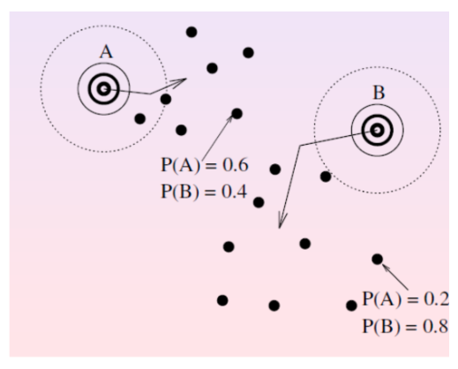
M-step: modify the parameter according to the probability
Notes:
-to maximize the likelihood of the data

Slide 35
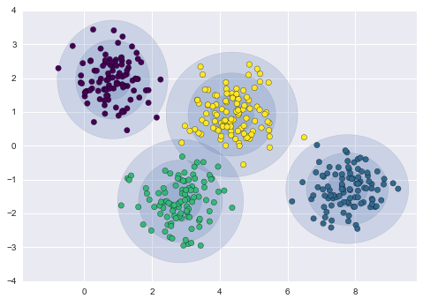

Slide 36
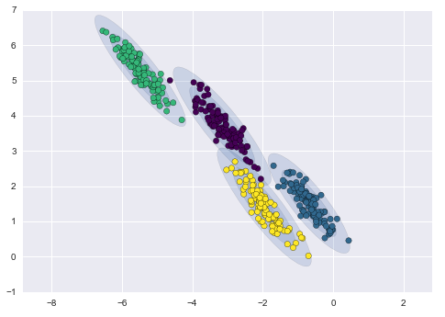

Slide 37
Covariance
-Measure of how changes in one variable are associated with changes in a second variable. It is often used informally as a general measure of how monotonically related two variables are.

Slide 38
Covariance type
Controls the degrees of freedom in the shape of each cluster
Scikit-learn specific parameters (not for Spark)
Covariance_type
“diag”
“spherical”
“full”

Slide 39
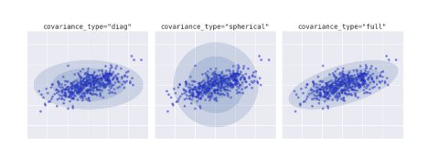

Slide 40
Spark version parameters
K (hyperparameters)
maxIter
tol
Notes:
-maxIter: total number of iterations over the data; default 100
-tol: threshold value; smaller value can lead to higher accuracy at the cost of more computing power; default 0.01

Slide 41
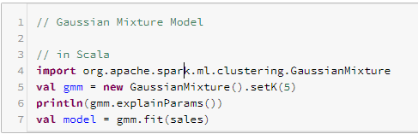
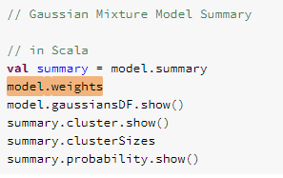

Slide 42
Latent Dirichlet Allocation
Notes:
Dir-ik-let

Slide 43
LDA
Latent Dirichlet Allocation (LDA) is a hierarchical clustering model typically used to perform topic modelling on text documents. LDA is a Bayesian version of pLSA.
In particular, it uses dirichlet priors for the document-topic and word-topic distributions, lending itself to better generalization.
LDA tries to extract high-level topics from a series of documents and keywords associated with those topics.
It then interprets each document as having a variable number of contributions from multiple input topics.
There are two implementations that you can use: online LDA and expectation maximization.
Notes:
Plsa: Probabilistic latent semantic analysis: probabilistic latent semantic indexing.

Slide 44
Online LDA and Expectation Maximization
In general, online LDA will work better when there are more examples.
Expectation maximization optimizer will work better when there is a larger input vocabulary. This method is also capable of scaling to hundreds or thousands of topics.
Goal:
LDA answers the question: “given this type of distribution, what are some actual probability distributions I am likely to see?”

Slide 45
Example
Consider the very relevant example of comparing probability distributions of topic mixtures.
Let’s say the corpus we are looking at has documents from 3 very different subject areas. If we want to model this, the type of distribution we want will be one that very heavily weights one specific topic, and doesn’t give much weight to the rest at all.
If we have 3 topics, then some specific probability distributions we’d likely see are:

Slide 46
Example continued
Mixture X: 90% topic A, 5% topic B, 5% topic C
Mixture Y: 5% topic A, 90% topic B, 5% topic C
Mixture Z: 5% topic A, 5% topic B, 90% topic C

Slide 47
Random Probability Issues
If we draw a random probability distribution from this dirichlet distribution, parameterized by large weights on a single topic, we would likely get a distribution that strongly resembles either mixture X, mixture Y, or mixture Z.
It would be very unlikely for us to sample a distribution that is 33% topic A, 33% topic B, and 33% topic C.
That’s essentially what a dirichlet distribution provides: a way of sampling probability distributions of a specific type.

Slide 48
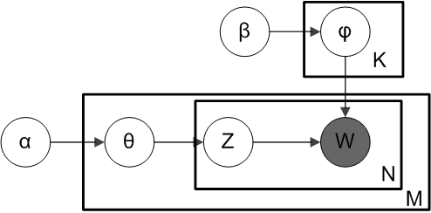
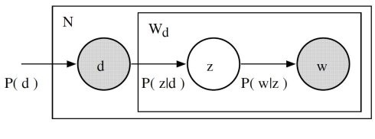
LDA overview
LDA
From a dirichlet distribution Dir(α), we draw a random sample representing the topic distribution, or topic mixture, of a particular document. This topic distribution is θ. From θ, we select a particular topic Z based on the distribution.
Next, from another dirichlet distribution Dir(𝛽), we select a random sample representing the word distribution of the topic Z. This word distribution is φ. From φ, we choose the word w.
pLSA(Probabilistic latent semantic analysis)
Document d, topic z is present P(z|d), word w is drawn from z with probability P(w|z)
Notes:
Word generation next slide.

Slide 49
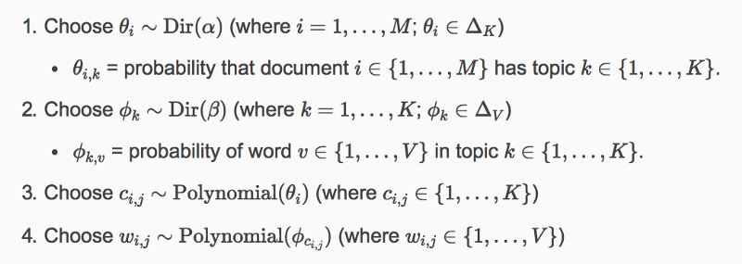
Word Generation
Notes:
Note, this algorithm shown uses c instead of z to represent the topic.

Slide 50
Strength of LDA
Lda typically performs better than similar algorithms like pLSA due to its ability to generalize new documents easily.
In LDA, the dataset serves as training data for the dirichlet distribution of document-topic distributions.
If we haven’t seen a document, we can easily sample from the dirichlet distribution and move forward from there.

Slide 51
LDA and Spark
As we have previously covered in prior chapters, Spark needs to work with numeric formats.
In order to input our text data into LDA, we’re going to have to convert it into a numeric format.
You can use the CountVectorizer to achieve this, which was previously talked about in Chapter 25. Preprocessing and Feature Engineering.

Slide 52
Setting up LDA in Spark
Model Hyperparameters:
k: The total number of topics to infer from the data. The default is 10 and must be a positive number.
docConcentration: Dirichlet parameter for prior over documents’ distributions over topics. Larger values encourage smoother inferred distributions.
topicConcentration: Dirichlet parameter for prior over topics’ distributions over terms (words). Larger values encourage smoother inferred distributions.

Slide 53
Training Parameters
optimizer: Optimizer to use for learning the LDA model, either EMLDAOptimizer or OnlineLDAOptimizer
maxIterations: Limit on the number of iterations.
checkpointInterval: If using checkpointing (set in the Spark configuration), this parameter specifies the frequency with which checkpoints will be created. If maxIterations is large, using checkpointing can help reduce shuffle file sizes on disk and help with failure recovery.
learningDecay: Learning rate, set as an exponential decay rate. This should be between (0.5, 1.0] to guarantee asymptotic convergence. The default is 0.51 and only applies to the online optimizer.
learningOffset: A (positive) learning parameter that downweights early iterations. Larger values make early iterations count less. The default is 1,024.0 and only applies to the online optimizer.
optimizeDocConcentration: Indicates whether the docConcentration (Dirichlet parameter for document-topic distribution) will be optimized during training. The default is true but only applies to the online optimizer.
subsamplingRate: The fraction of the corpus to be sampled and used in each iteration of mini-batch gradient descent, in range (0, 1]. The default is 0.5 and only applies to the online optimizer.
Seed: This model also supports specifying a random seed for reproducibility.
Notes:
Also mention you can always do the algorithm.explainParam to get this information from spark.

Slide 54
Prediction Parameters
topicDistributionCol: The column that will hold the output of the topic mixture distribution for each document.

Slide 55
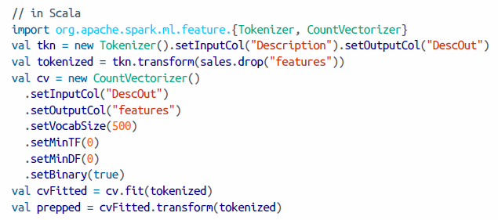
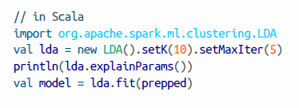
Code Example
Notes:
TAB OUT TO SHOW THIS ON DATABRICKS

Slide 56
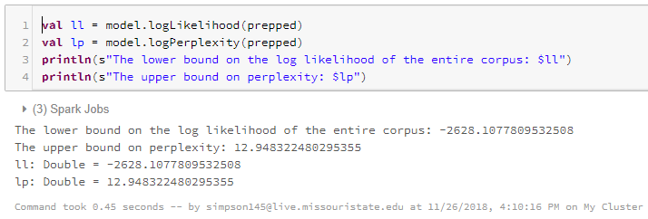
LDA Code Output

Slide 57
Remarks on the Model
Spark allows you to see the topics extracted from the documents. They are stored as term indices.
They can be looked up using the CountVectorizerModel that was previously trained.
For an example, we can check the top 3 topics on our trained data by looking them up in our vocabulary.

Slide 58
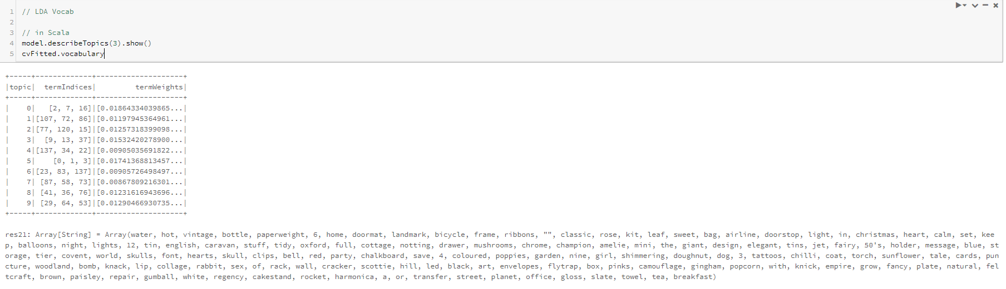
Vocabulary Code and Results
Notes:
Why use LDA? Teacher example (not knowing topic of paper/wanting to grade or TA grade it)

Slide 59
LDA Conclusions
The goal of these tools is to help you optimize the number of topics, based on your data.
Spark tends to favor online LDA in order to optimize the parameters allowed.
With LDA, we can extract human-interpretable topics from a document corpus, where each topic is characterized by the words they are most strongly associated with.
The resulting vectors are often very useful for downstream applications.

Slide 60
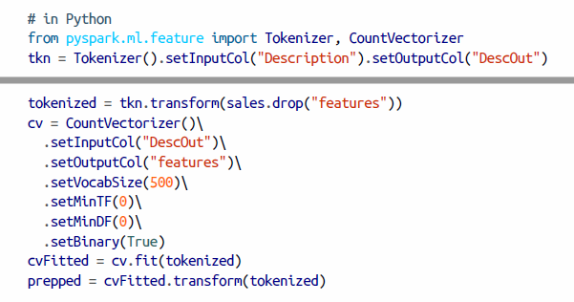
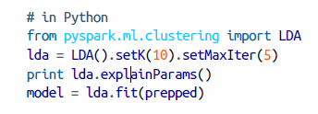

Python Examples (for reference)

Slide 61
Chapter Conclusion
K-means
Bisecting K-means
Gaussian Mixture Model
Latent Dirichlet Allocation (LDA)
Notes:
Blab a little bit about each section

Slide 62
Sources
http://stanford.edu/class/ee103/visualizations/kmeans/kmeans.html
https://jakevdp.github.io/PythonDataScienceHandbook/05.12-gaussian-mixtures.html
https://github.com/llSourcell/Gaussian_Mixture_Models/blob/master/intro_to_gmm_%26_em.ipynb
https://spark.apache.org/docs/latest/mllib-clustering.html#bisecting-k-means
https://www.linkedin.com/pulse/initial-investigation-k-means-bisecting-algorithms-dave-blodgett/
https://medium.com/nanonets/topic-modeling-with-lsa-psla-lda-and-lda2vec-555ff65b0b05

Slide 63
Questions?

